Slide 1

CS244 Coursework Project

Slide 2
Instructions before Discussion Day
Fill your project info in this sheet https://docs.google.com/spreadsheets/d/1iIHTPmWSNdQF0czCfs6LjkNiTejl05hKAg1jZaIDqlA/edit?usp=sharing
Upload your source code + document to this folder (do not print). (Due date 23 may). rare the app and document to one file and name it as project name https://www.dropbox.com/request/LttC4pYdjqpXdSjbh1HL
Prepare PowerPoint presentation according to this template for discussion day
In discussion day, bring your laptop to make presentation and show application code.
Discussion slot limited only to 15 minutes to present your slides. So be will prepared.
Absent member will not be graded.

Slide 3
Rubric

Slide 4
Presentation Template
Starts from next slide

Slide 5
Project Cover page
Orphan Charity Organization
Charity Organizations
Team members :
-Mahmoud Ahmed
-Yahya Salah Abdelhameed
-Ali Mohamed -Abdelrahman Nabil
-Kirolos Refaat

Slide 6
System objective
Why the customer needs the system (1 point)
Manage information more efficiently - The system will allow the organization to centrally store and manage all information regarding the children they support, donors, and volunteers in a digital database. This is likely more efficient than manual files and spreadsheets.
Improve communication - The system can provide communication features like email and a message board to help staff and volunteers stay up to date and collaborate more effectively.
Track metrics and report to donors/funders - The system can generate reports and metrics on key aspects of the organization's work like the number of children served, funds raised, and volunteer hours. This data is important for fundraising and reporting to donors and funders.
1/25

Slide 7
System FRs
2/25
Table 1: Functional Requirement Login
Table 3: Functional Requirement Create Orphan
Function Name | Login.
Description | A user has to login to start actions in the system.
Critically | Essential for making further actions in the system.
Technical issues | None.
Cost and schedule | None.
Risks | -Wrong passwords -E-mail not registered.
Dependencies with other requirements | User must register before login.
Pre-Condition | User not yet logged in.
Post-Condition | User have access to the system.
Function Name | Create Orphan
Description | Creating orphan record
Critically | Essential for adding orphan records to the system.
Technical issues | Orphan can have same name.
Cost and schedule | None.
Risks | None.
Dependencies with other requirements | Requires Admin login.
Pre-Condition | Oprhan Data Doesnt exist
Post-Condition | Can Create Oprhan
Table 2: Functional Requirement Enter Dashboard
Table 4: Functional Requirement Update Orphan
Function Name | Enter DashBoard
Description | A user has to login to access DashBoard.
Critically | Essential for making further actions in the system.
Technical issues | None.
Cost and schedule | None.
Risks | None.
Dependencies with other requirements | Requires High staff login.
Pre-Condition | Have a privellage
Post-Condition | Can access DashBoard
Function Name | Update Orphan
Description | Updating orphan record
Critically | Essential for Updating orphan records to the system.
Technical issues | None.
Cost and schedule | None.
Risks | None.
Dependencies with other requirements | Requires Admin login.
Pre-Condition | Oprhan Data exist
Post-Condition | Can update orphan

Slide 8
System FRs
2/25
Table 5: Functional Requirement Finance Reports
Function Name | Finance Reports
Description | Receiving reports from users in the same system
Critically | Essential checking if everything is going right
Technical issues | None.
Cost and schedule | None.
Risks | None.
Dependencies with other requirements | Requires Admin staff login.
Pre-Condition | Accountant Send Reports
Post-Condition | Can view reports
Table 6: Functional Requirement Warehouse Reports
Function Name | Warehouse Reports
Description | Receiving reports from users in the same system
Critically | Essential checking if everything is going right
Technical issues | None.
Cost and schedule | None.
Risks | None.
Dependencies with other requirements | Requires Admin staff login.
Pre-Condition | Warehouse Manger Send Reports
Post-Condition | Can view reports

Slide 9
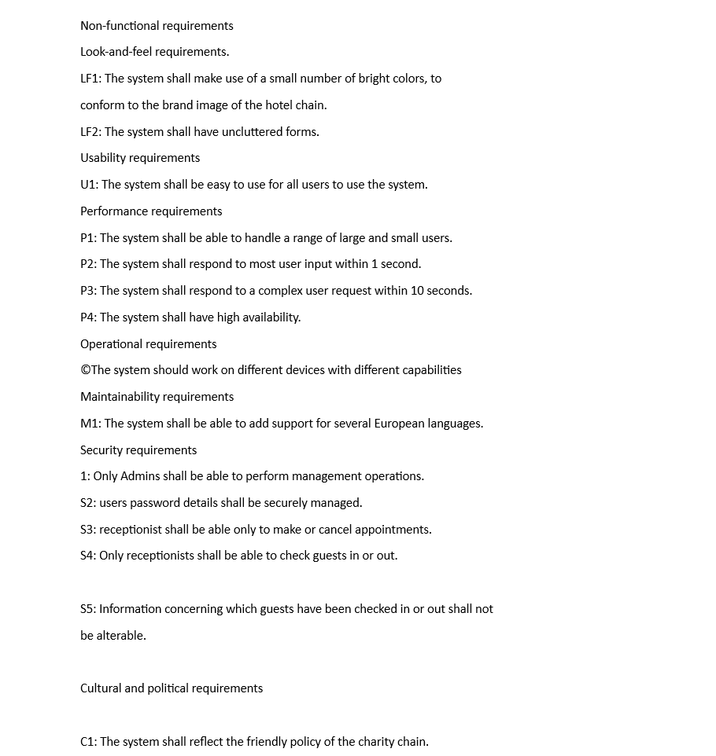
System NFRs
3/25

Slide 10
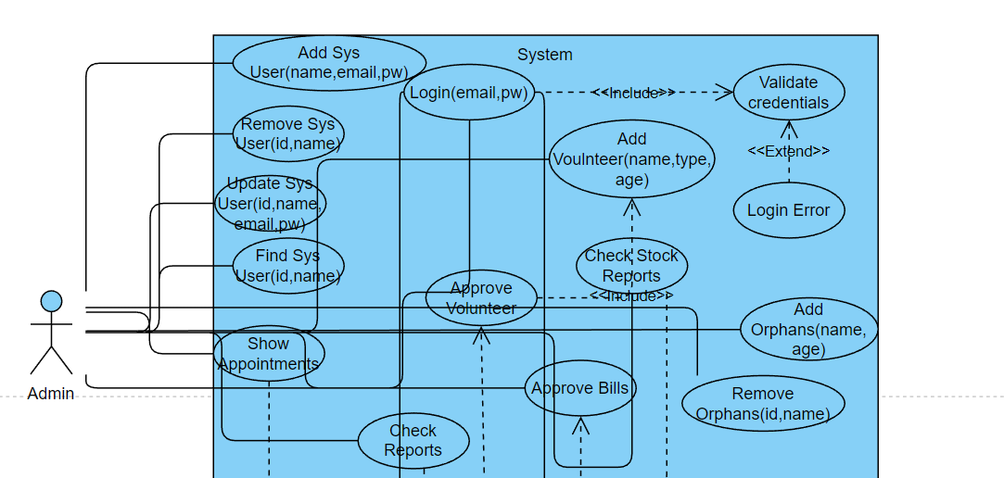
System scope: use case diagram
5/25

Slide 11
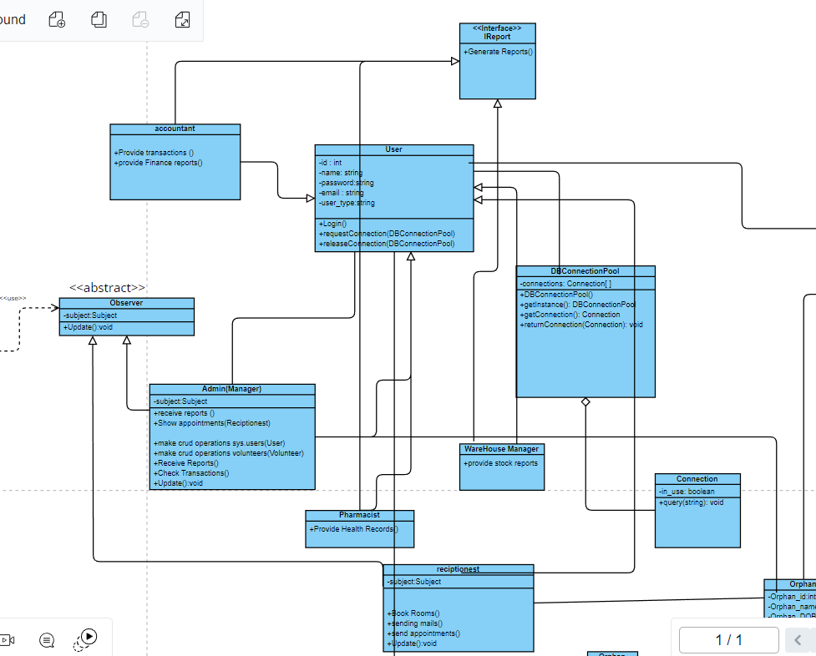
System structure: class diagram
8/25

Slide 12
Use case scenario
10/25
Identifier and name | Admin add user
Initiator | User (may be receptionist or accountant or warehouse manager)
Goal | Add the user to the system
Precondition | None
Postcondition | The user will be added to the system and has id, pw and email
Assumptions | The expected initiator is a receptionist. He is not already known to the software system
Main success scenario
1 | The admin select system users from the dashboard to add user
2 | The admin enter user (id, username, email, password)
3 | The admin enters add user.
4 | The user has been added to the system
5 | The system adds the user to the systems database
Extensions
3.a | user already exists
3.a.1 | Database is completed
Identifier and name | A receptionist books a room
Initiator | The guest (may be receptionist or accountant or warehouse manager or orphan)
Goal | A room is reserved for the orphan
Precondition | None
Postcondition | A room of the desired type will have been reserved for the guest for the requested period. and the room will no longer be free for that period.
Assumptions | The expected initiator is a orphan. He is not already known to the software system
Main success scenario
1 | The receptionist selects book room from the dashboard to books a room
2 | The receptionist enter room (number, orphan name, orphan id, date, time)
3 | The receptionist book room
4 | The system checks the availability of the rooms
5 | The system makes a booking and gives it a number if a room is available
6 | The system cancels a booking and send message “There are no rooms available” if the room is not available.
Extensions
3.a | Room not available
3.a.1 | The receptionist offer another date and time to the orphan
Identifier and name | Accountant provide transactions
Initiator | The accountant
Goal | Provide the transactions
Precondition | None
Postcondition | Transactions are provided by the accountant.
Assumptions | The expected initiator is a accountant. He is not already known to the software system
Main success scenario
1 | The accountant selects provide transactions from the dashboard
2 | The accountant enter id and select transaction type and enter the value, date and doner name
3 | The accountant provides transactions.
Extensions
3.a | The donor does not want to be named
3.a.1 | The id of the transactions was missing

Slide 13
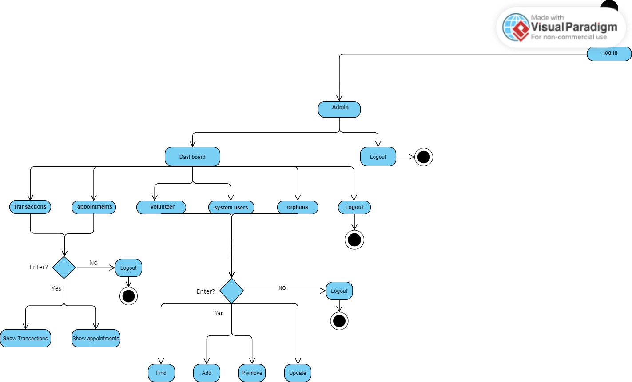
Activity diagram
12/25
Admin()

Slide 14
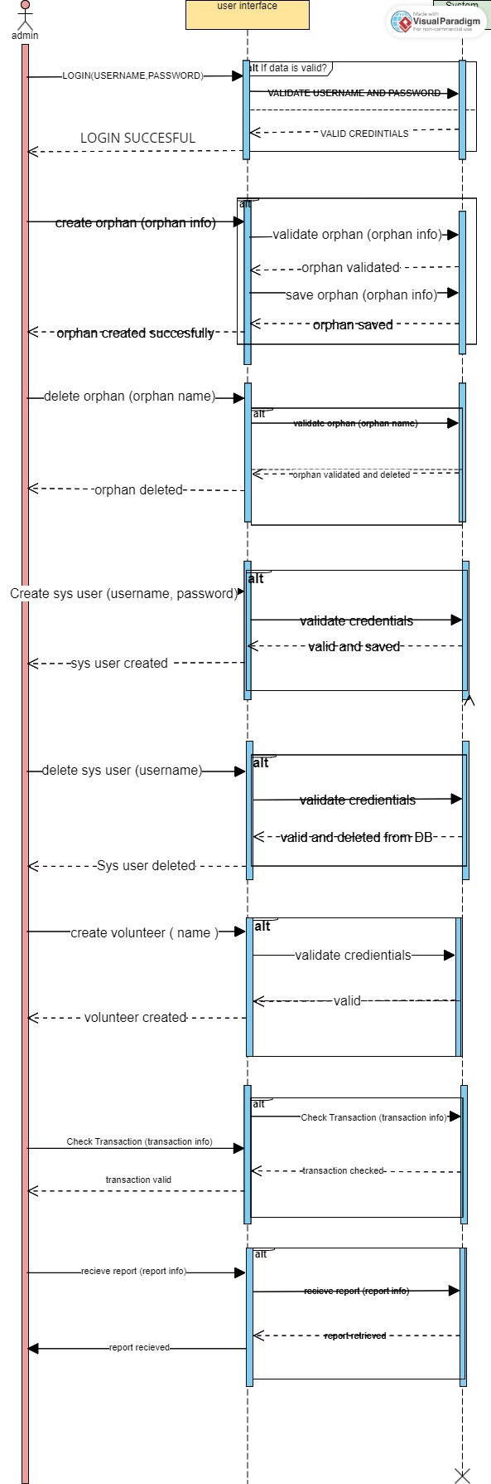
Sequence diagram
14/25
Admin()

Slide 15
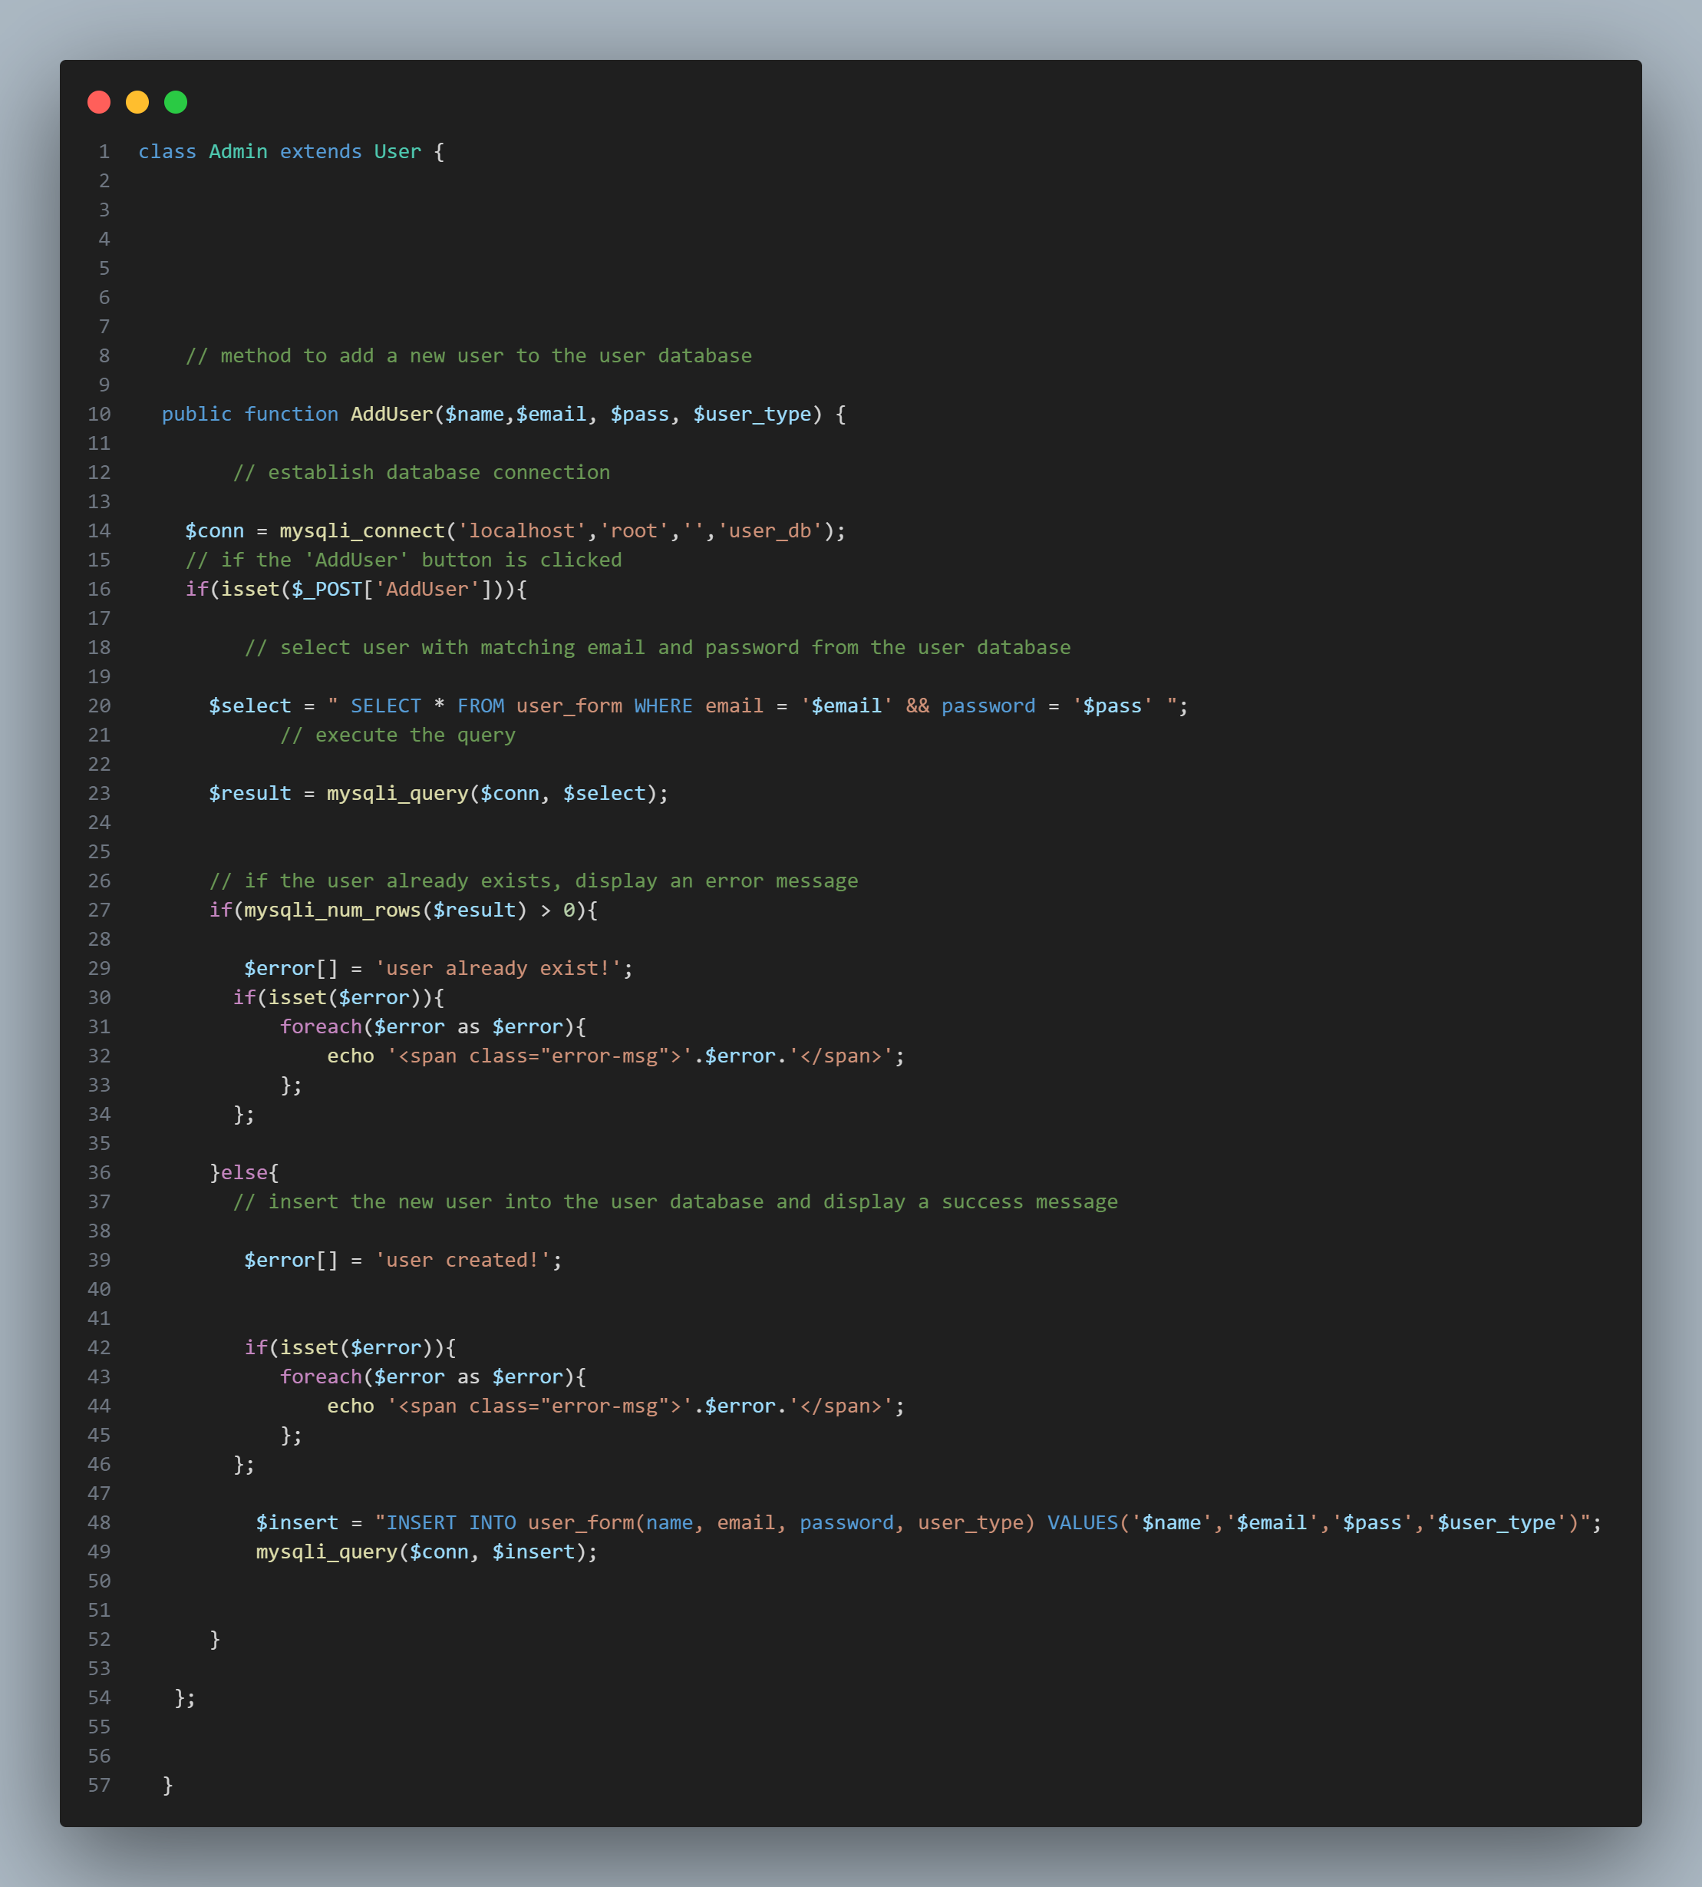
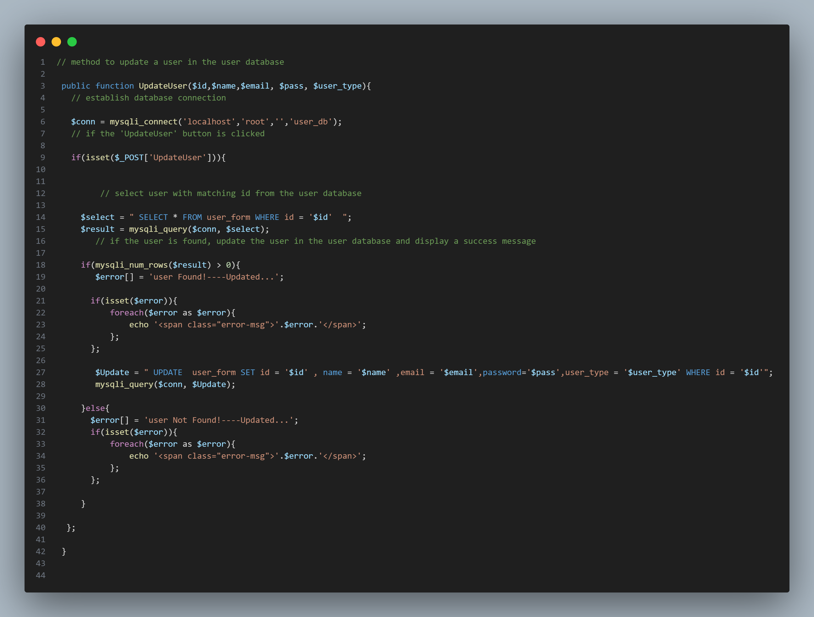
CRUD implementation
16/25
Update SYS User
ADD SYS User

Slide 16
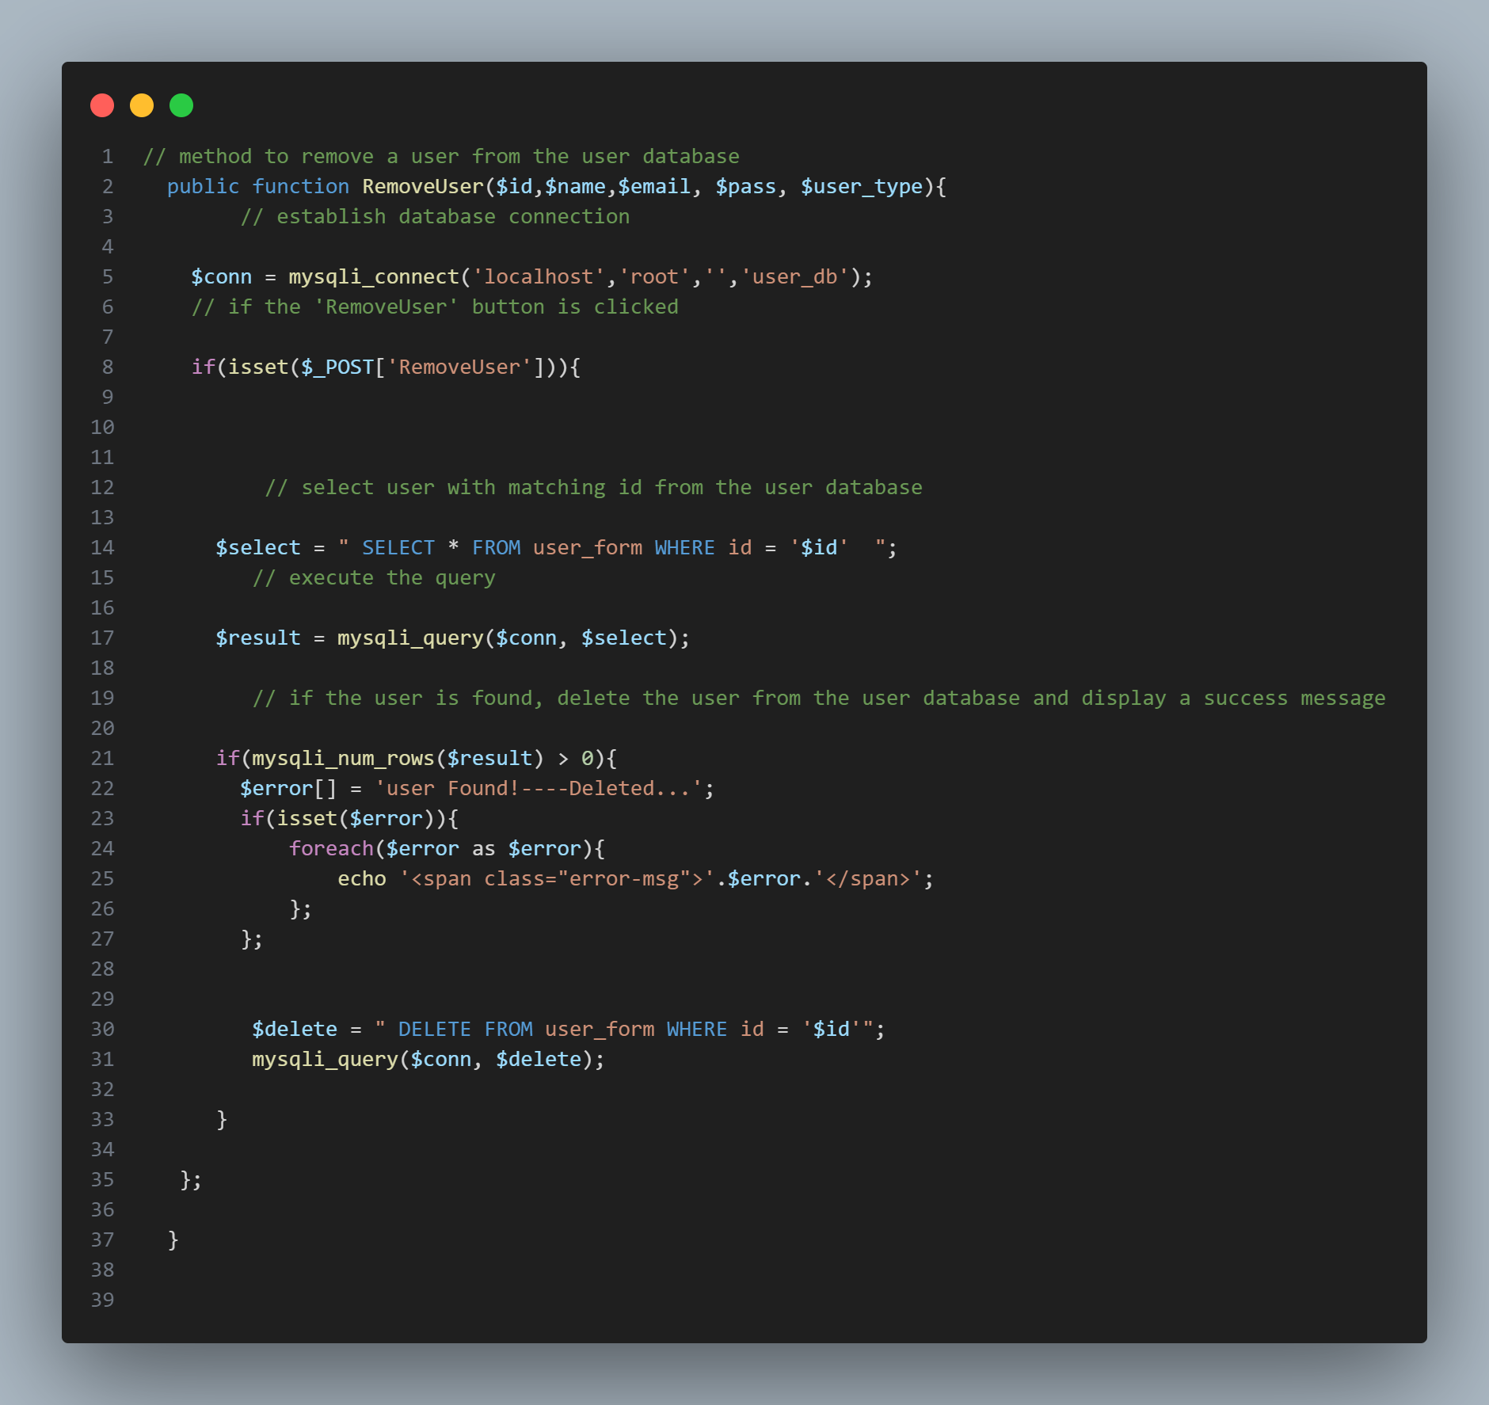
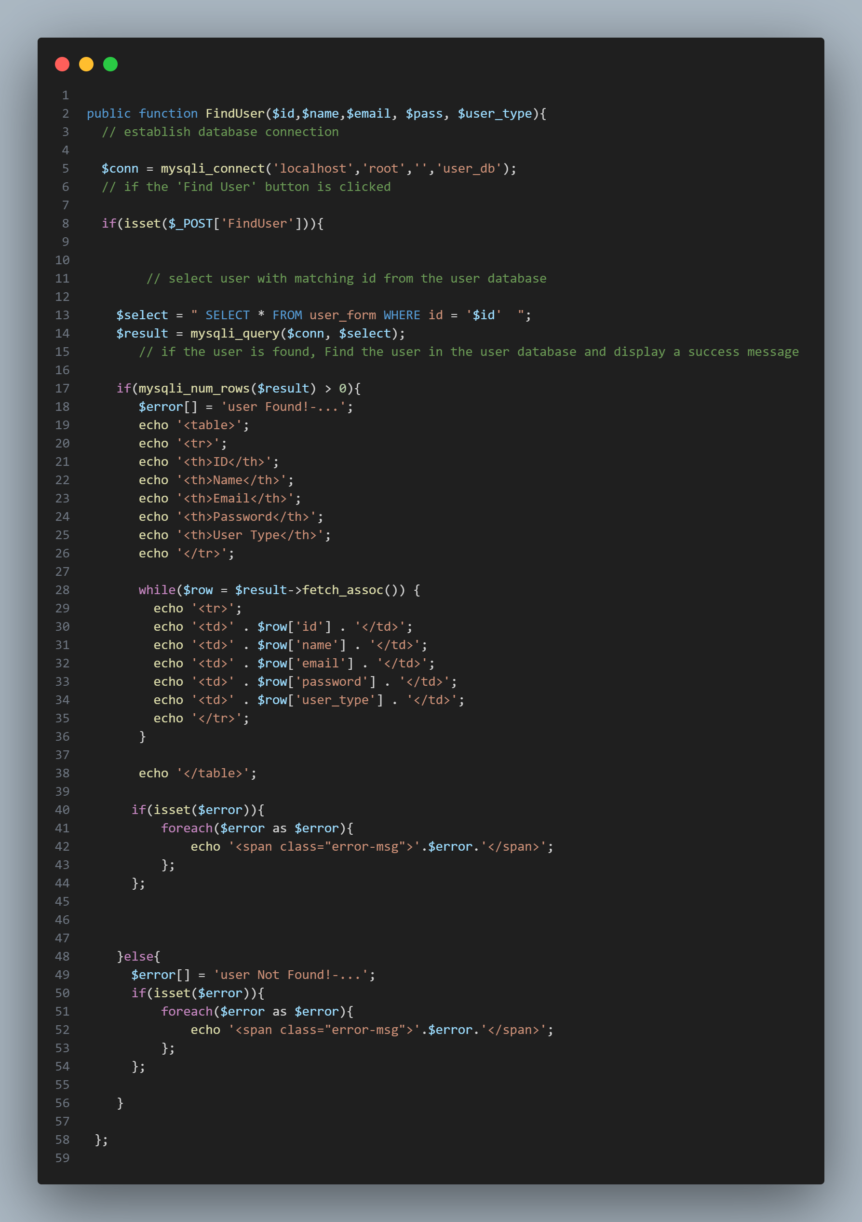
CRUD implementation
16/25
Remove SYS User
Find SYS User

Slide 17
Applying architecture patterns
Show screen from solution that proof that you applied MVC or any other architecture patterns (1 point)
17/25

Slide 18
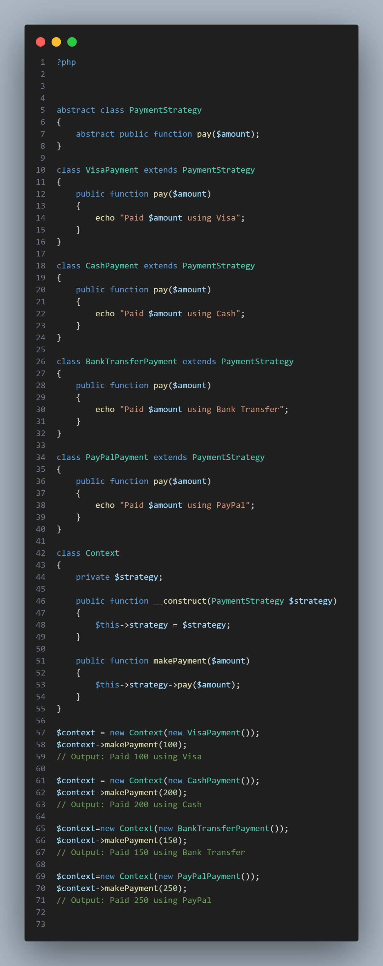
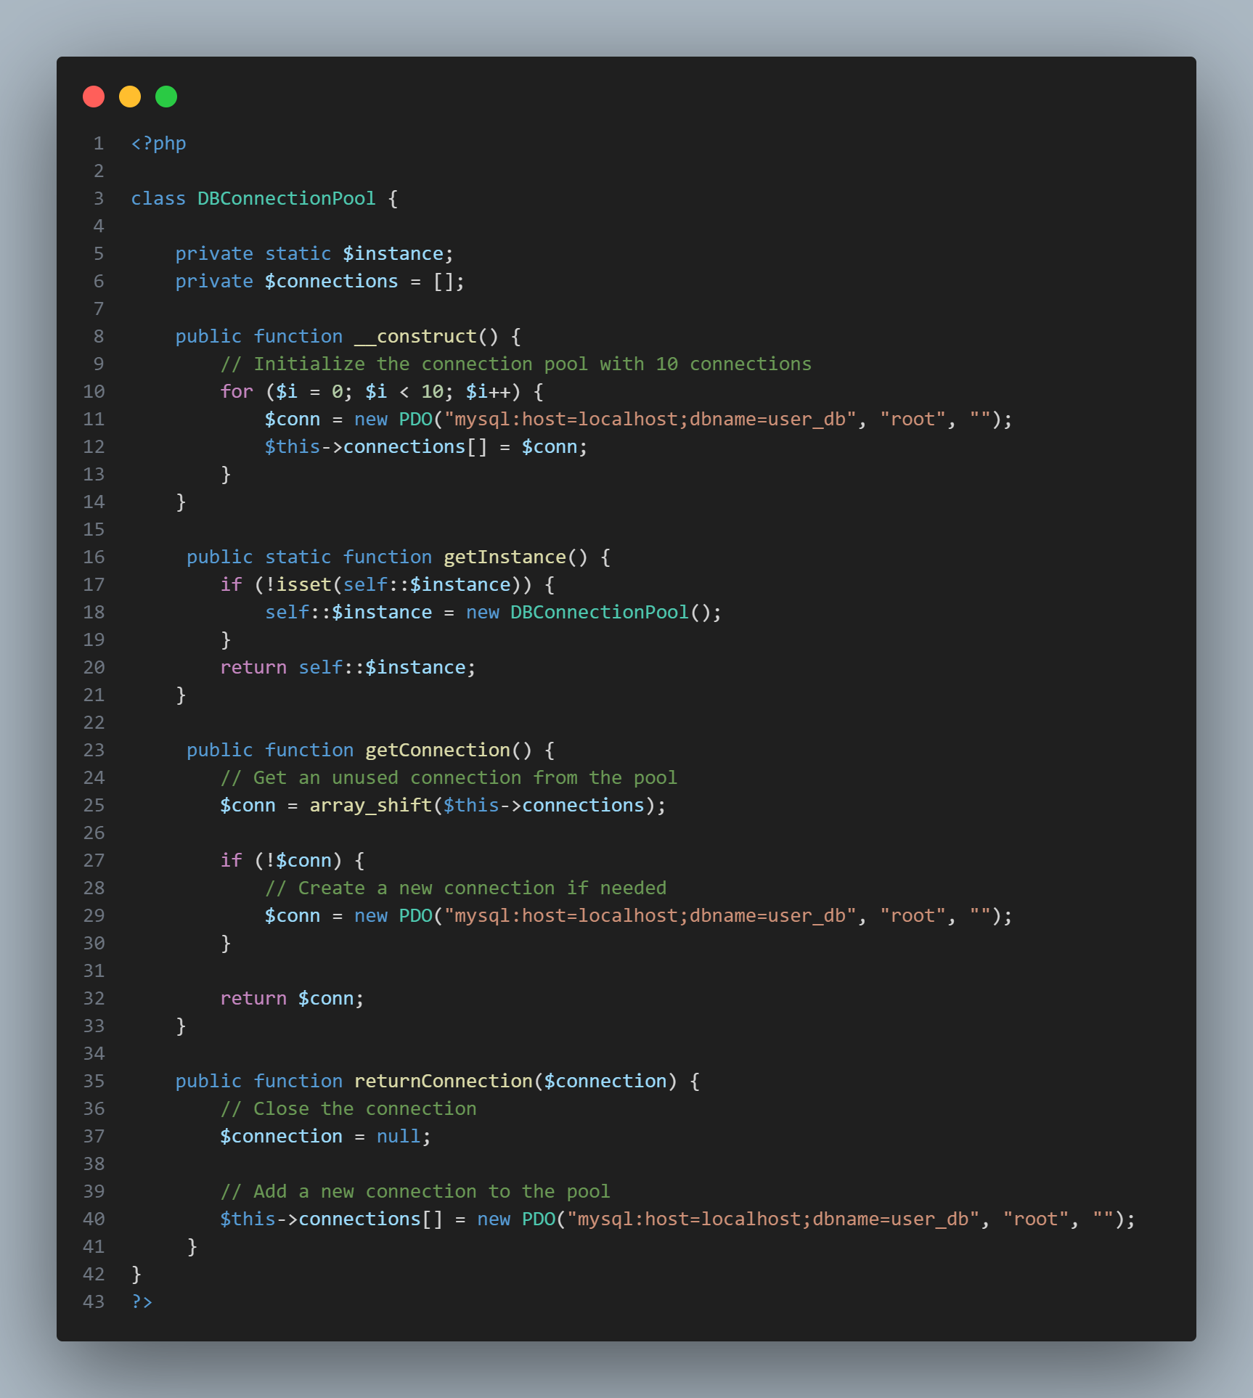
Applying design patterns
23/25
Singleton(db)
Stragety(Payment)

Slide 19
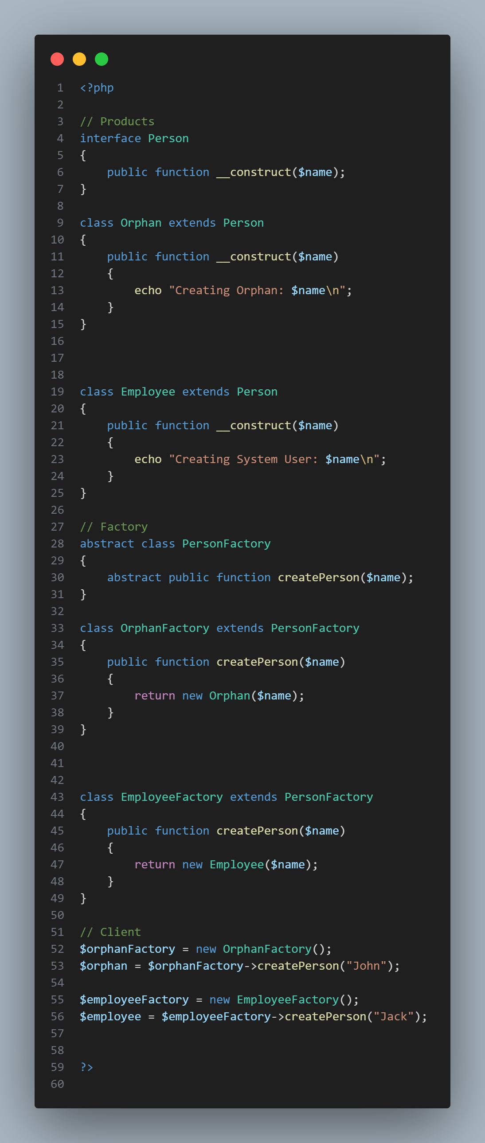
Applying design patterns
23/25
Factory(Create User/Orphan)

Slide 20
System Document
25/25

Slide 21
Bonus
Running Application (2 point)
Put snipping from system life screens with data relevant
Real customer/real system need/society service (3 points)
Who is your customer
5/5

